Slide 1

Automatic Web-Based Data Sourcing System Presented by: Team A
Empowering Insights, Enhancing Efficiency
Dynamic Microservice's Generations

Slide 2

Dynamic Microservice Generations
Automatic Web-Based Data Sourcing and Integration System.

Slide 3

INTRODUCTION
Integrating disparate data sources seamlessly holds significant importance in today's data-driven world.

Slide 4

Significance of Integration:

Slide 5
Significance of Integration:
In the digital age, organizations accumulate vast amounts of data from various sources such as databases, APIs, and external platforms.
Integrating these disparate data sources seamlessly is vital for obtaining a comprehensive and accurate view of the business landscape.

Slide 6
Significance of Integration:
Seamless integration enables the synthesis of data silos, fostering a holistic understanding of customer behavior, market trends, and operational efficiencies.
It allows businesses to make informed decisions, identify patterns, and extract valuable insights, leading to strategic advantages in competitive markets.

Slide 7
Goal of a User-Friendly Frontend
Creating a Cohesive, User-Friendly Frontend Enhanced Visibility and Control:
A user-friendly frontend provides stakeholders and users with a centralized platform to monitor the integrated data sources in real-time.
It offers clear, intuitive visuals that translate complex data into easily digestible information, empowering users to comprehend trends and anomalies effortlessly.

Slide 8
At the heart of our project lies the goal of creating a user-friendly frontend that acts as a centralized hub for monitoring and managing the integrated data. The frontend isn't just a visual interface; it's a strategic tool designed to enhance user experience and streamline decision-making processes.

Slide 9
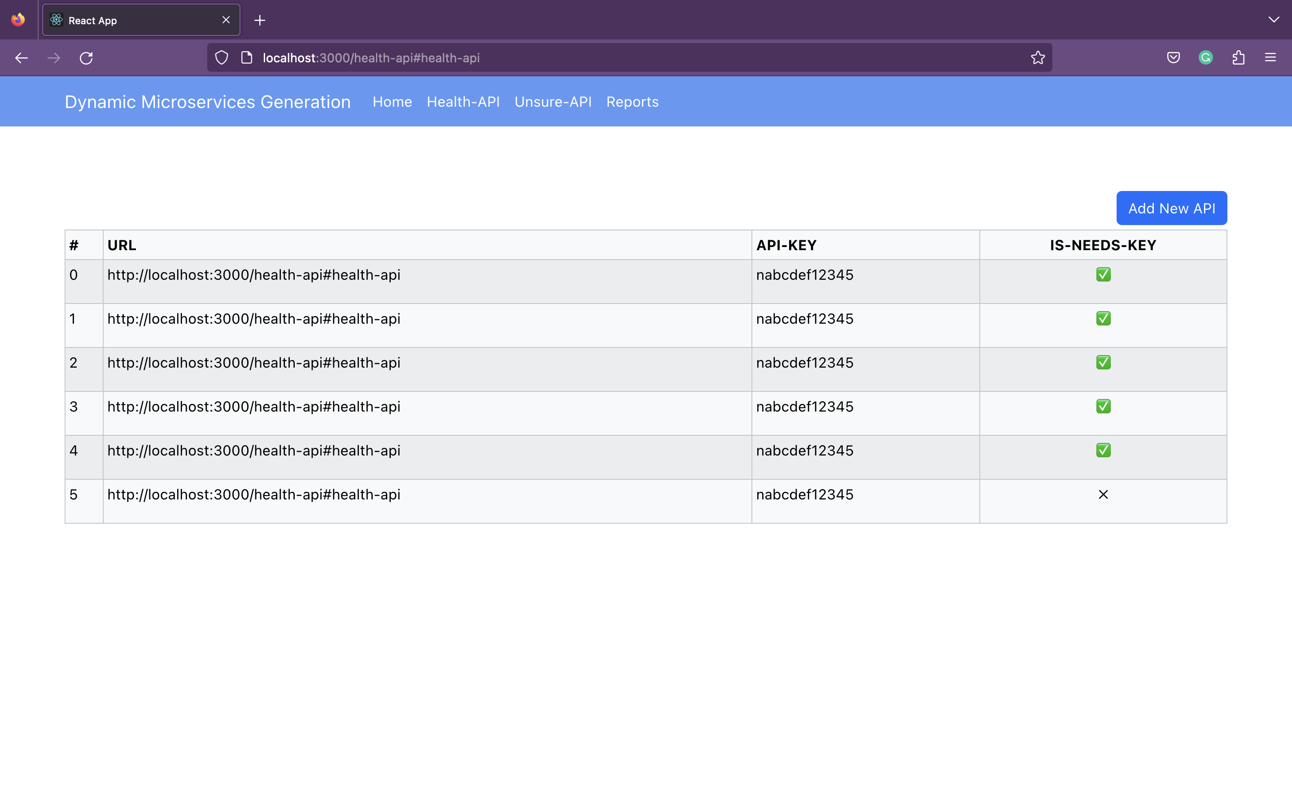
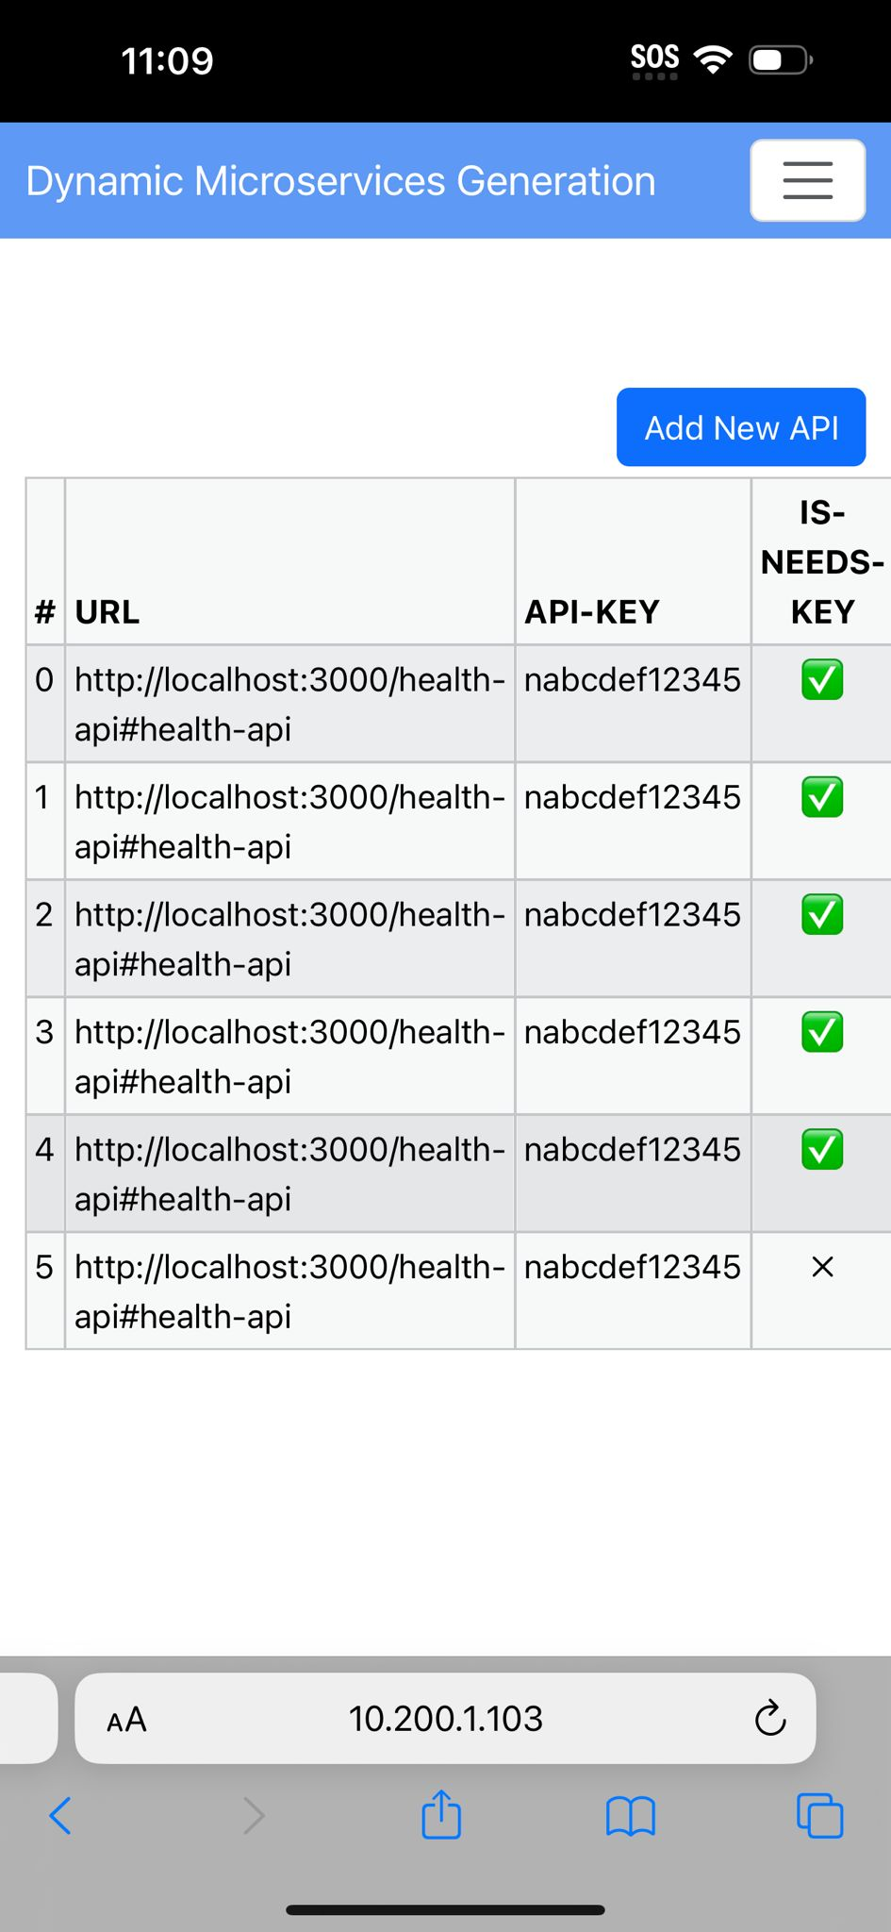
LIST OF HEALTH API

Slide 10
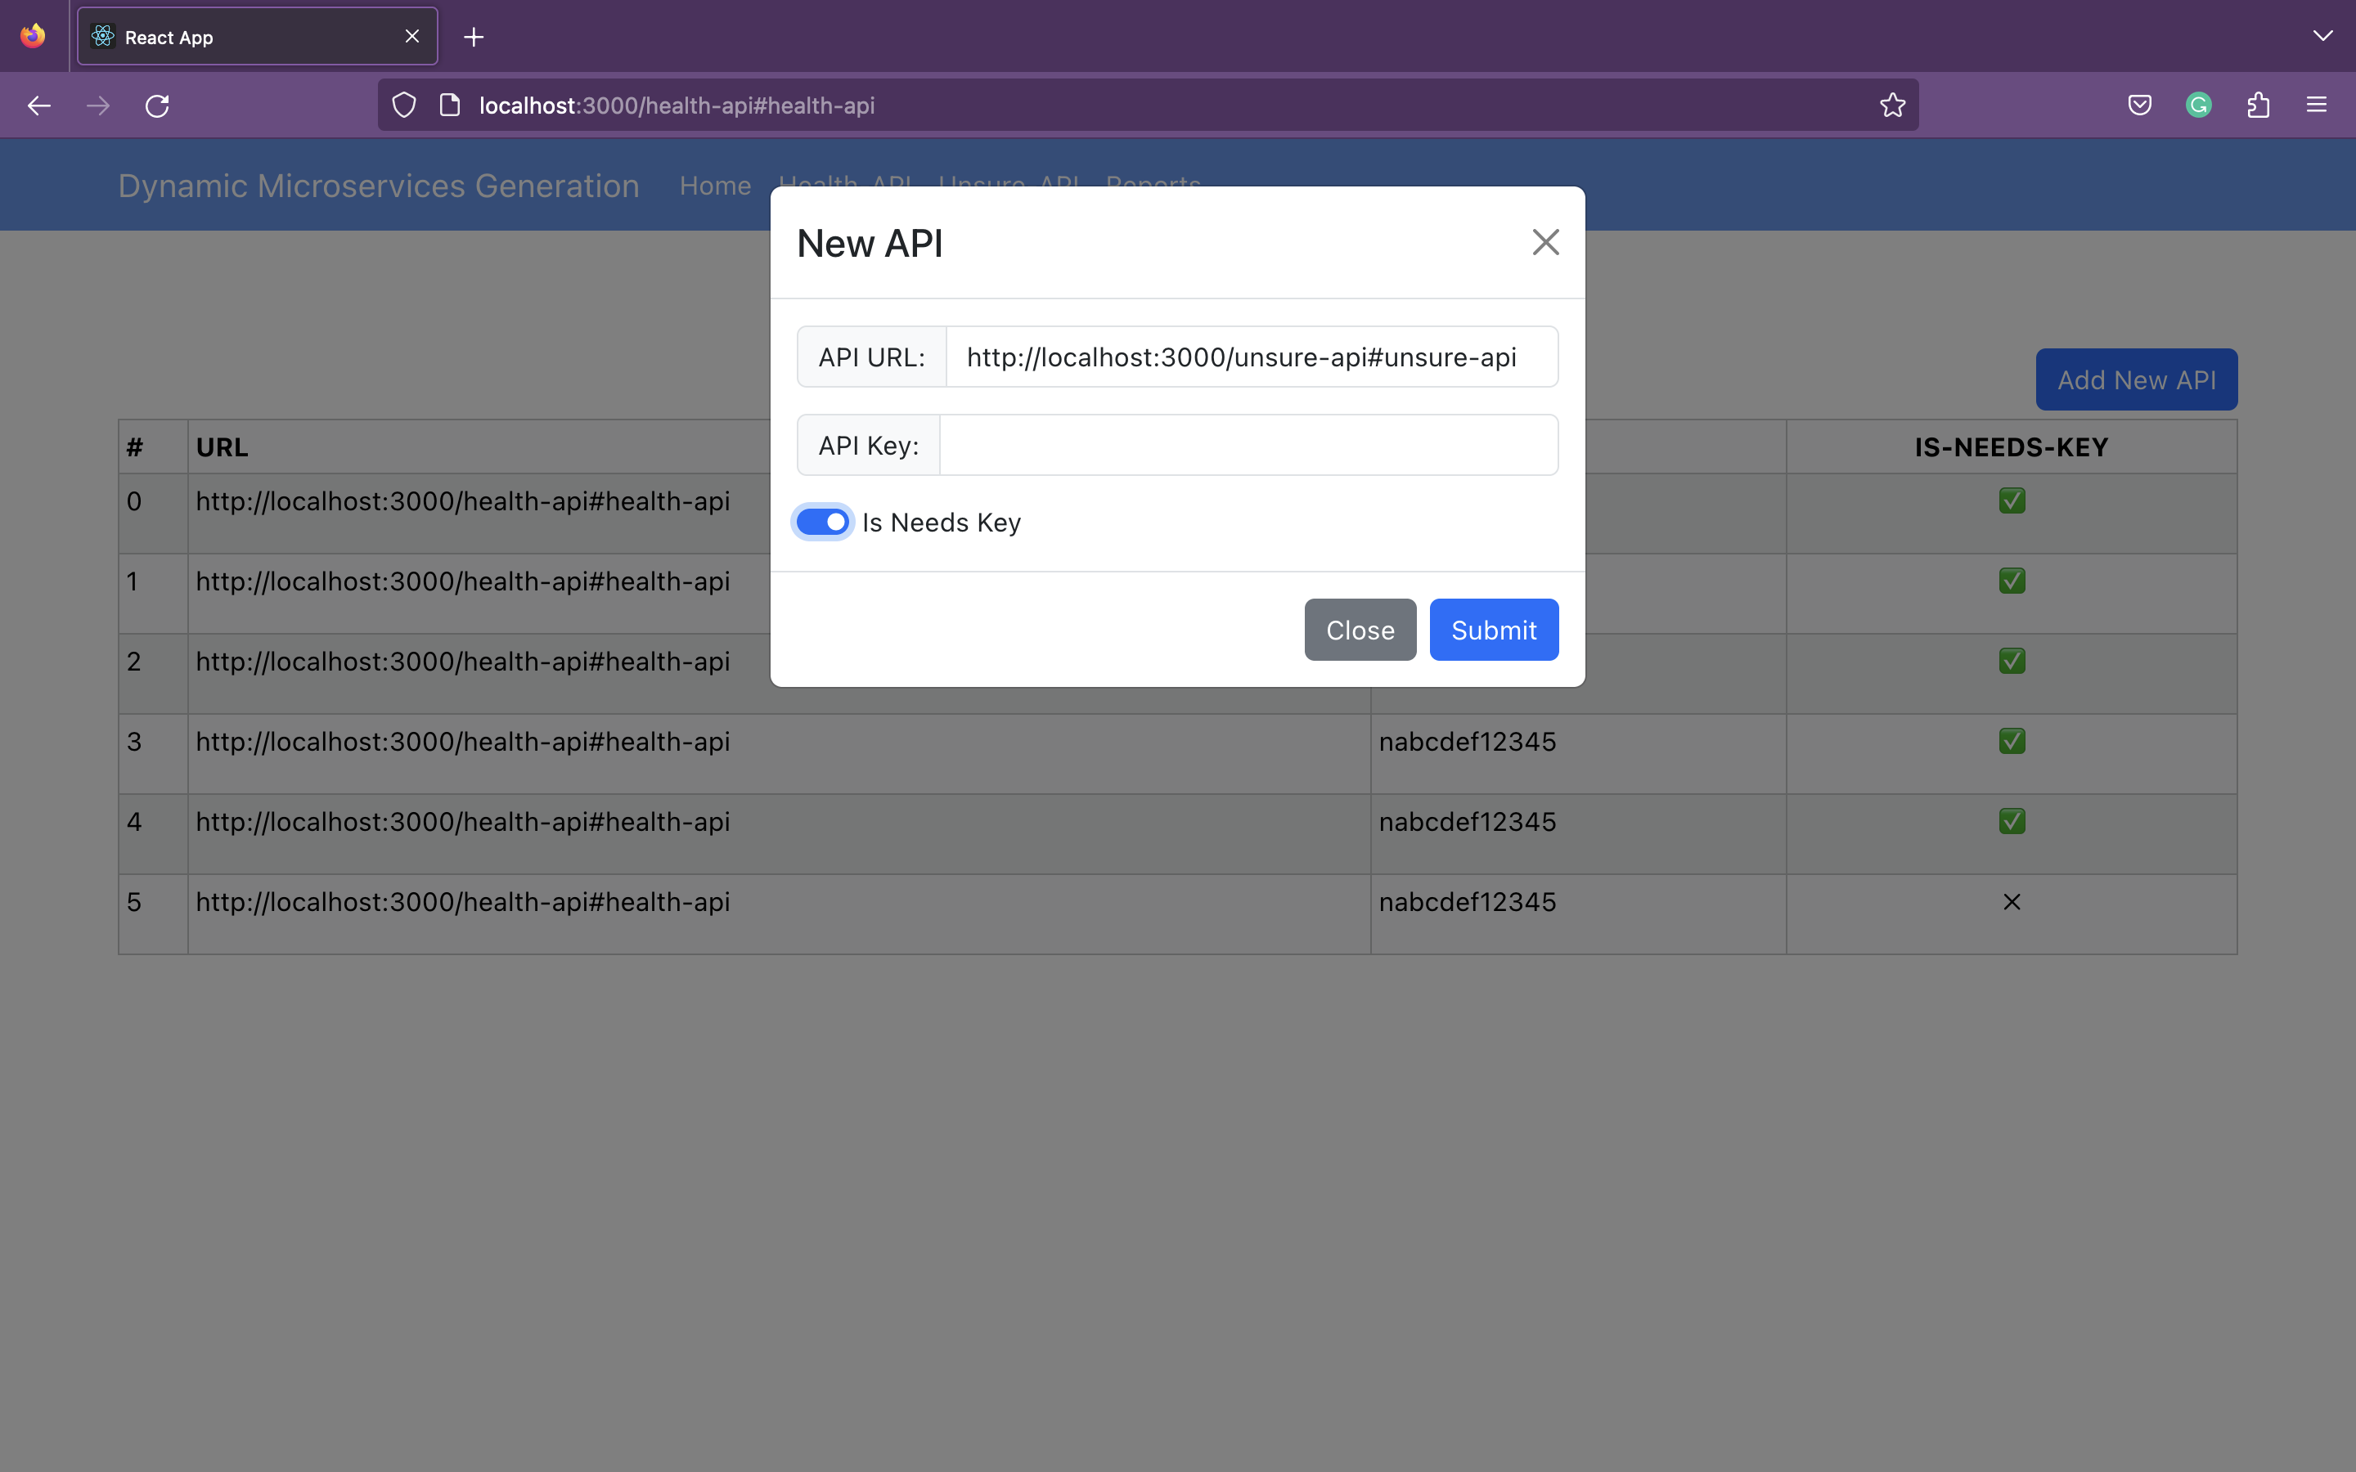
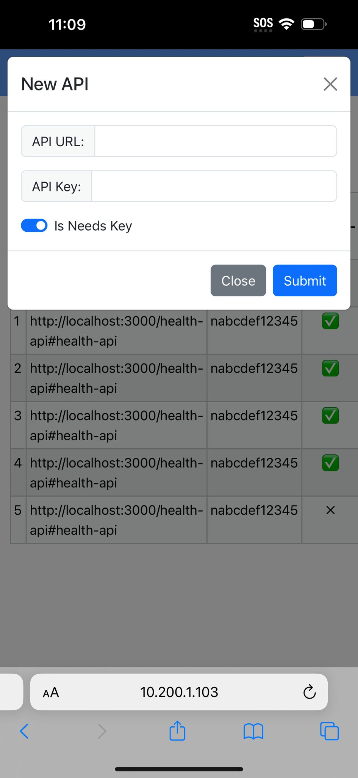
Add new API

Slide 11
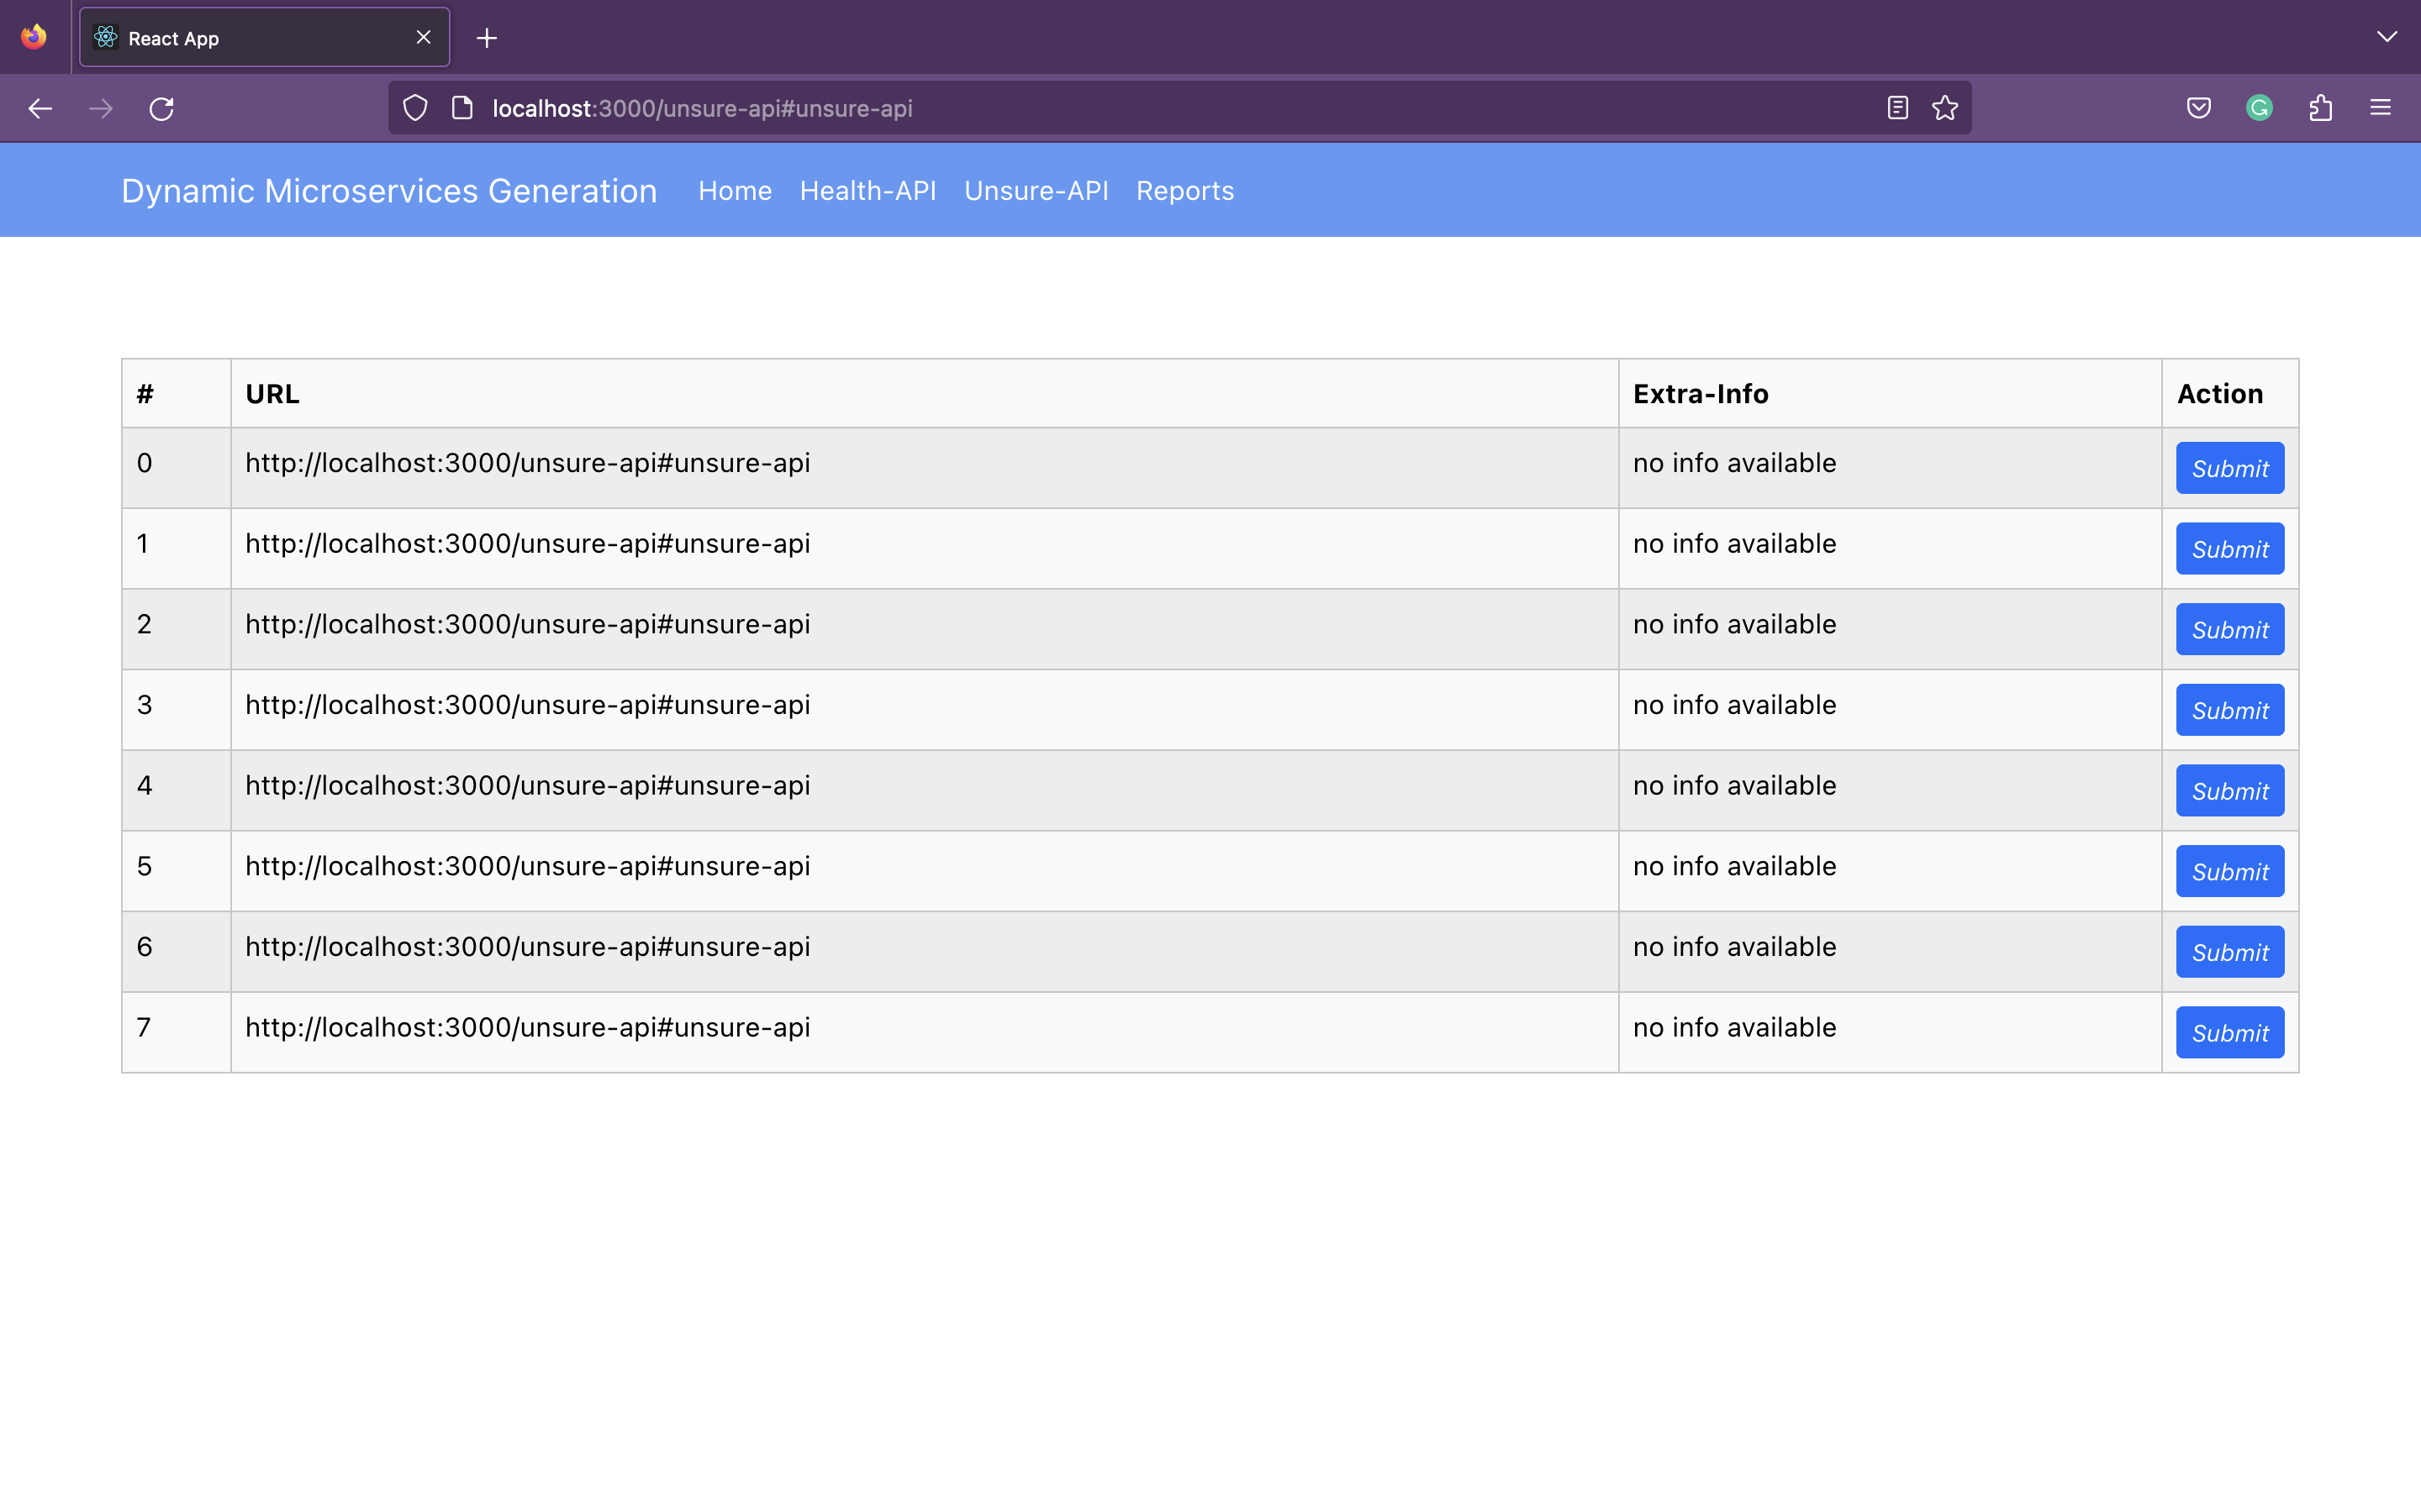
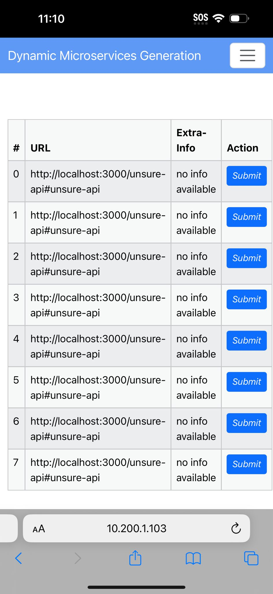
List of unhealth api

Slide 12
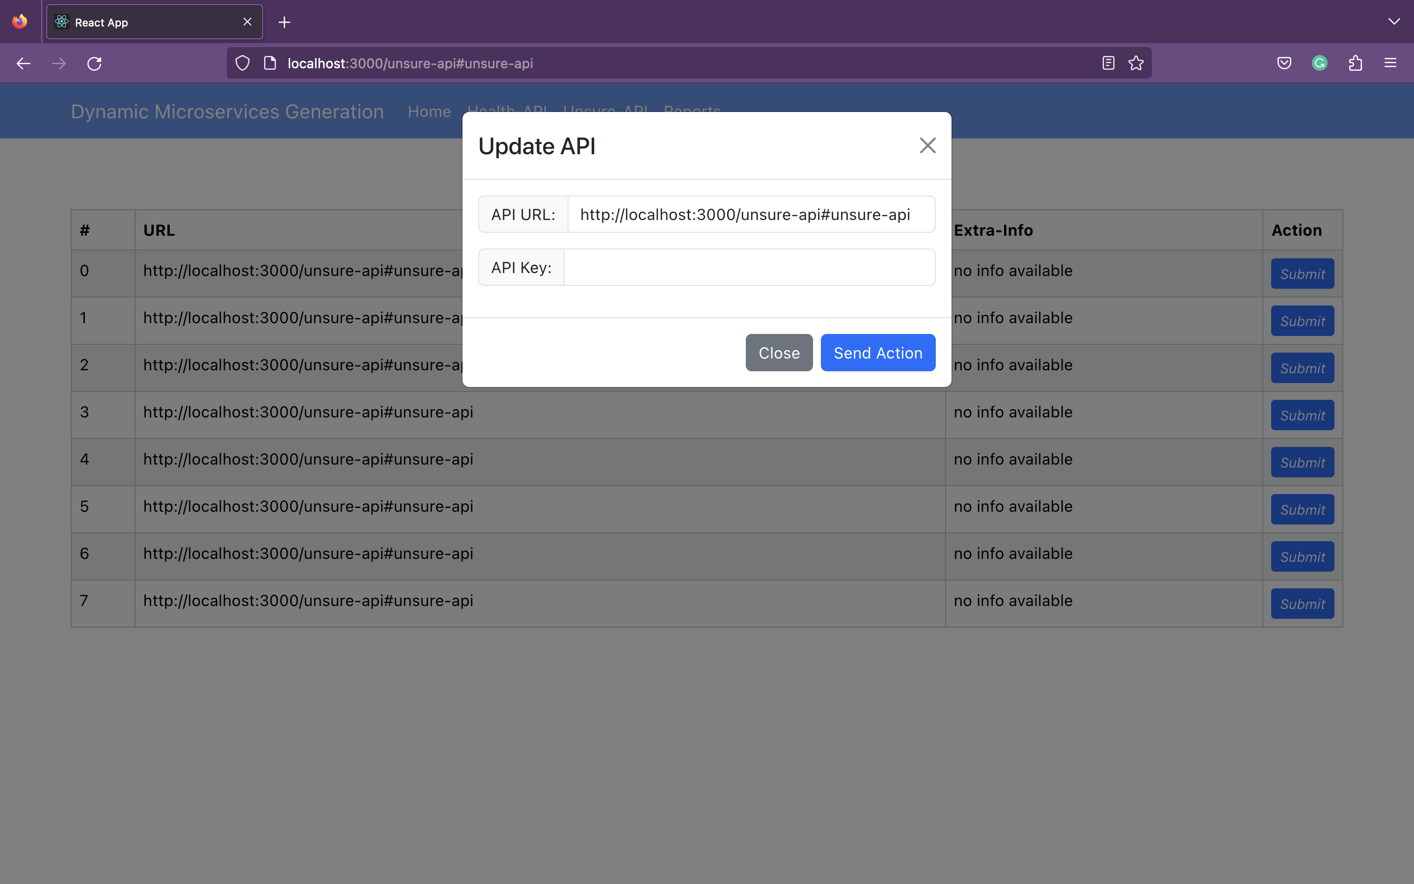
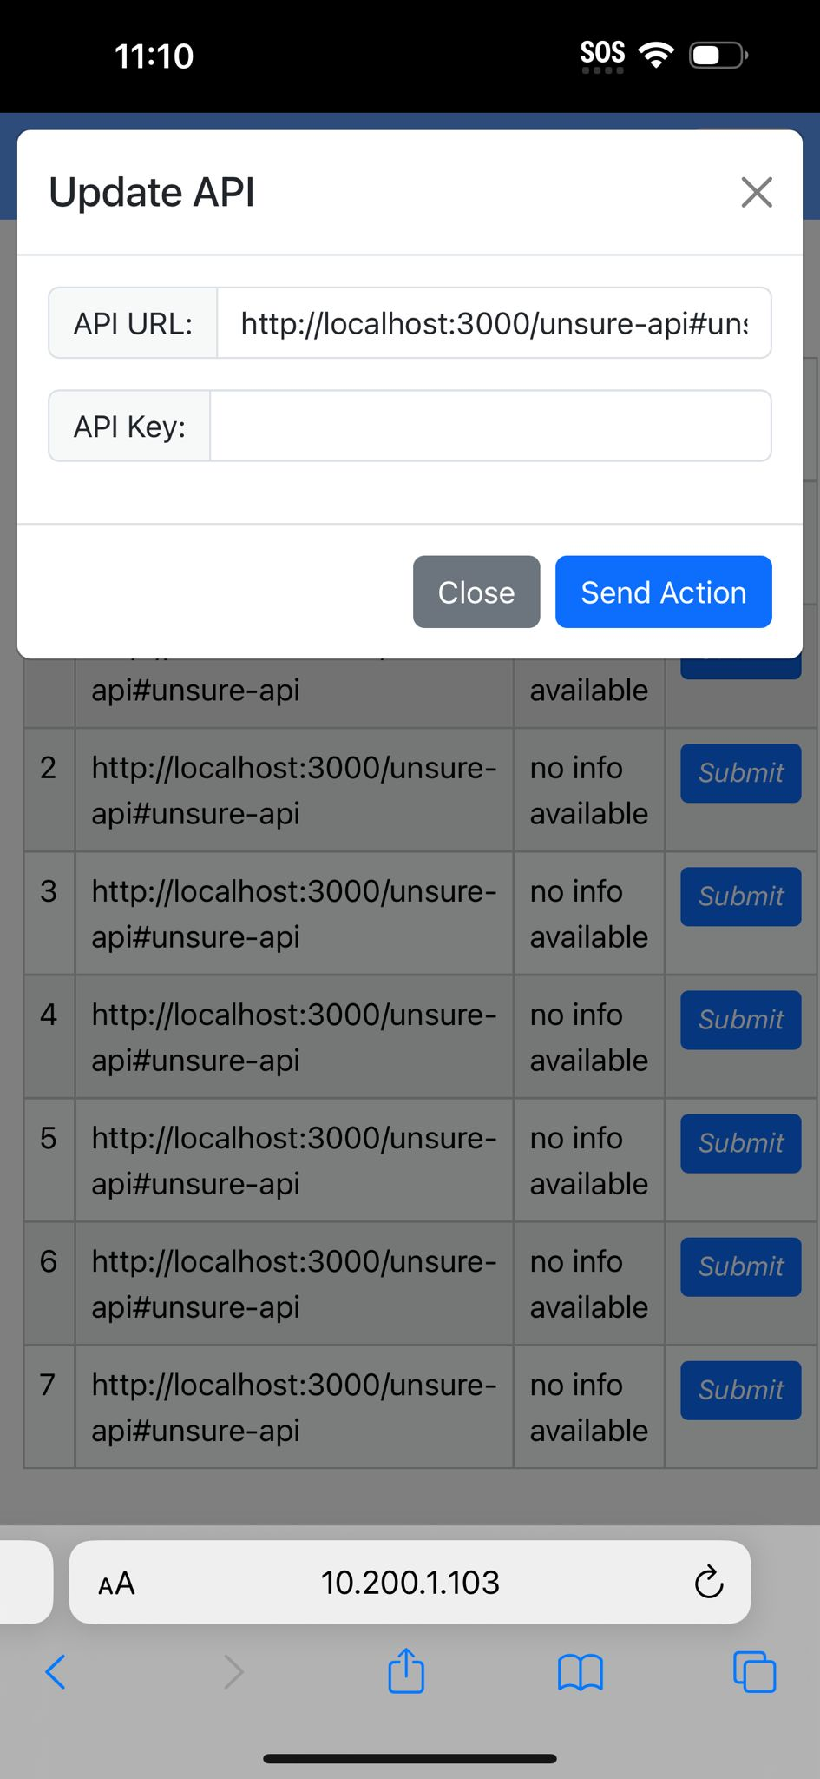
Update existing API

Slide 13
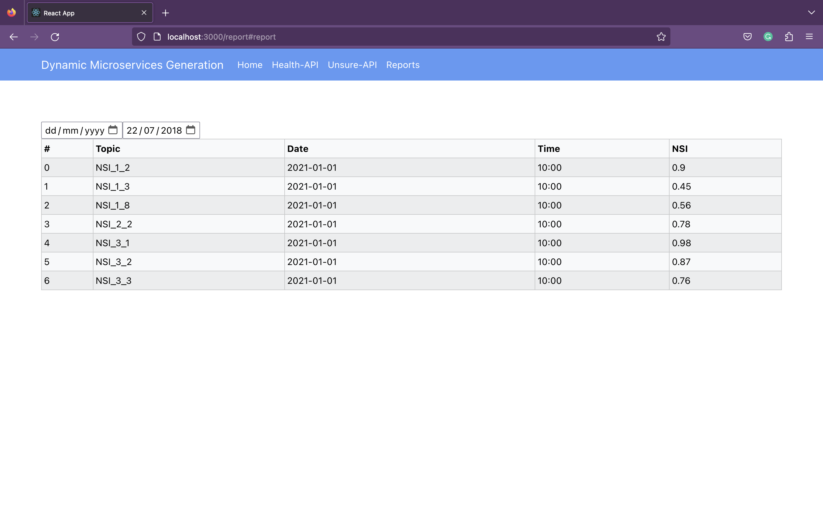
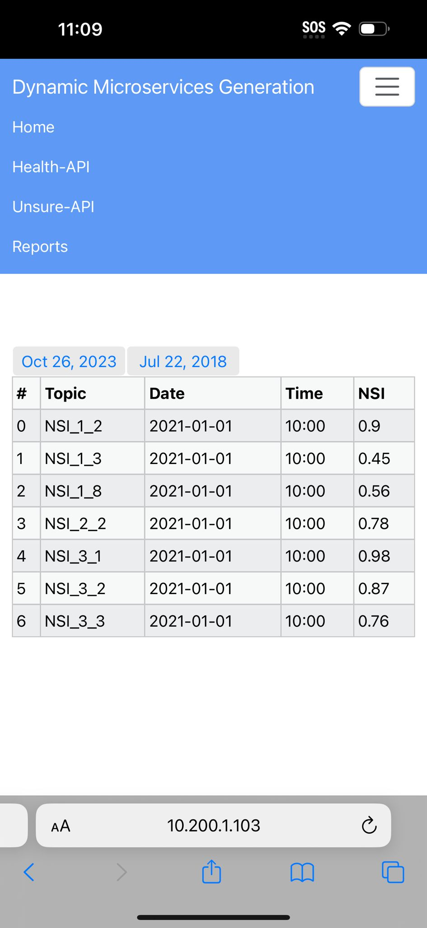
reporting

Slide 14
Optimized User Experience:
A well-designed frontend enhances the overall user experience, making it enjoyable and productive for users to interact with the system.
Intuitive navigation, responsive design, and interactive features contribute to a positive user experience, promoting user engagement and satisfaction.

Slide 15
Efficient Decision-Making:
A cohesive frontend streamlines the data management process, enabling quick and efficient decision-making.
Users can customize the frontend according to their preferences, focusing on specific data points or service activities relevant to their roles.

Slide 16
Improved Collaboration:
A user-friendly interface fosters collaboration among team members, ensuring that everyone is on the same page regarding the data integration activities.
It encourages communication, allowing users to share insights and collaborate seamlessly, leading to a more agile and responsive organization.

Slide 17
Improved Collaboration
Our user-friendly frontend fosters collaboration among team members. By providing a shared platform for data analysis, team members can collaborate seamlessly, sharing insights and knowledge. This collaborative environment leads to agile responses and well-informed decisions.

Slide 18
Efficient Decision-Making:
Customization is key. Users can tailor their dashboard, focusing on specific data points and service activities relevant to their roles. This customization promotes efficient decision-making by ensuring that users have access to the precise information they need, precisely when they need it.

Slide 19
Challenges
Front End:
working on three different UI designs for Android, IOS, and Web responsive.

Slide 20
Challenges
creating the backend service:
Make sure to fetch all the messages on Kafka not only the latest messages added to the Topic
configuring the Kafka broker, hence consuming more time trying to connect our project to the Broker.

Slide 21

What’s next
LOOKING AHEAD

Slide 22



Slide 23

Dynamic Content Creation

Slide 24
The future of AI and front-end development is expected to be dynamic and transformative, with several exciting trends and advancements on the horizon

Slide 25

Summary
our project's frontend isn't merely a visual layer; it's a strategic asset.

Slide 26
Our user-friendly frontend stands as a testament to our commitment to revolutionizing data integration, one intuitive click at a time.

Slide 27
THANK YOU
TEAM A
Any Question?
Abdelmadjid Guessabi
Antonedei Wonimidei Otoro
Hozifa Siddig Mohammed Zeanalabdeen
Micheal Habte
Omar Amjed Salim Khraim
Sokchea Chim

